Slide 1






Design Review
David Gitz, EE, ICARUS Lead Engineer
I C A R U S
Notes:
Yo mama

Slide 2
Team
Michael Welling
  PhD Candidate
  ICARUS Vehicle Engineer
Ben Wasson
  Masters Student
  ICARUS Business Manager
David Gitz
  Electrical Engineer
  ICARUS Lead Engineer

Slide 3

Applications
System Description
Capabilities
Development Progress
Q&A

Slide 4


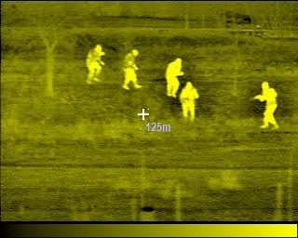
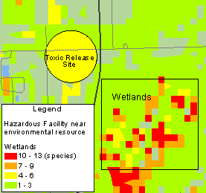

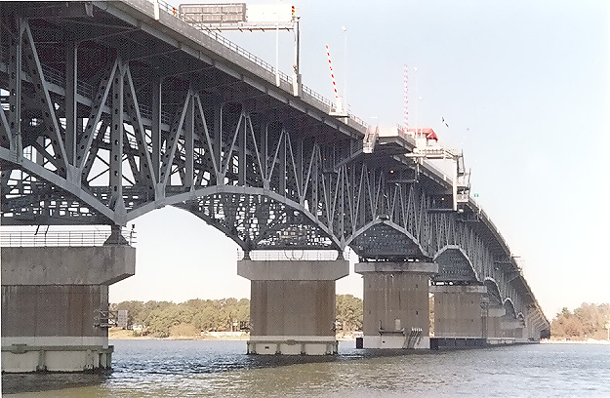

Slide 5

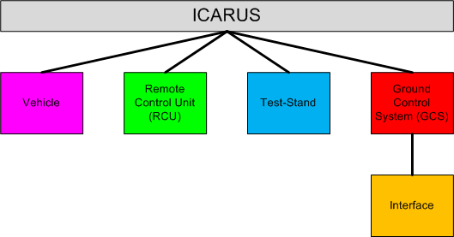
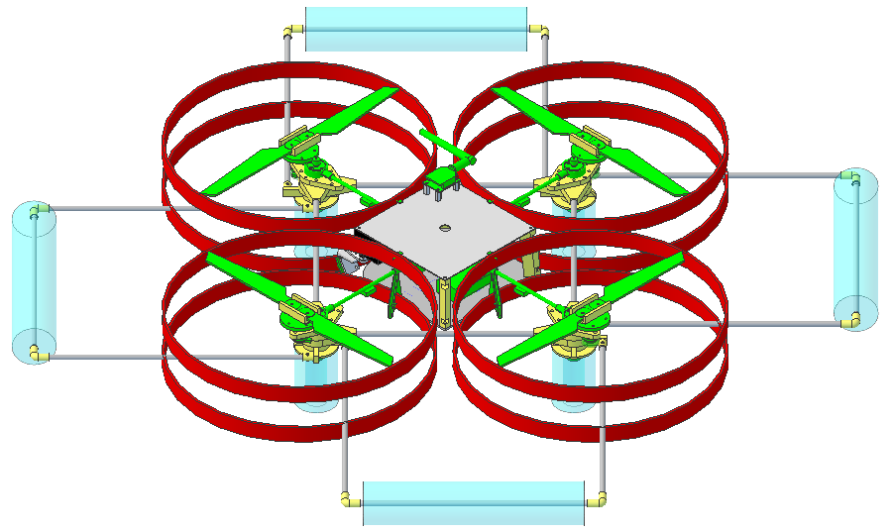
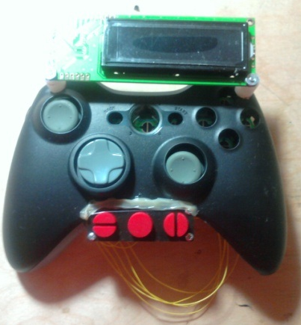
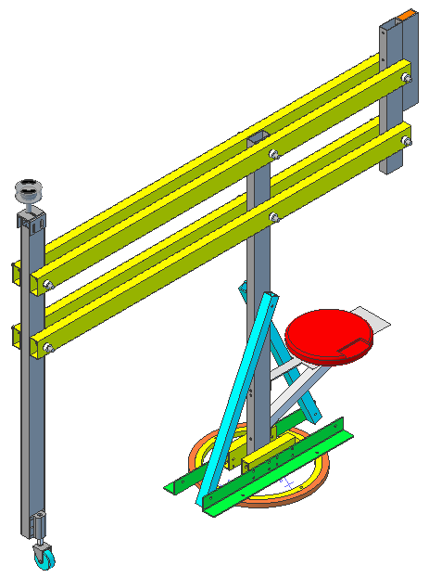
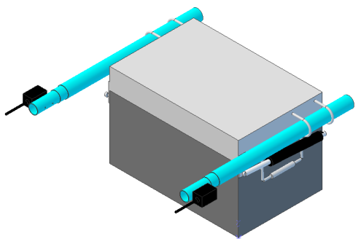
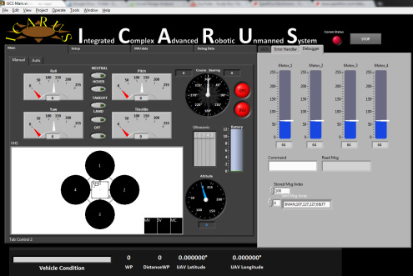

Slide 6
Vehicle

Slide 7

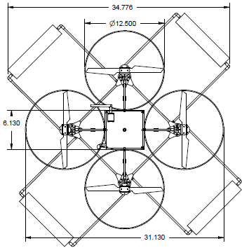
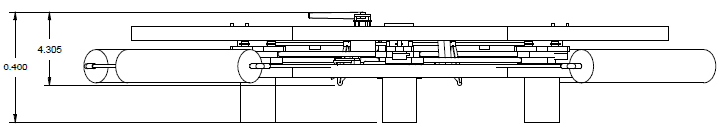
Quad-Rotor design – Offers simpler control system with fewer moving parts than a single rotor helicopter and minor reduction in lift capacity

Slide 8

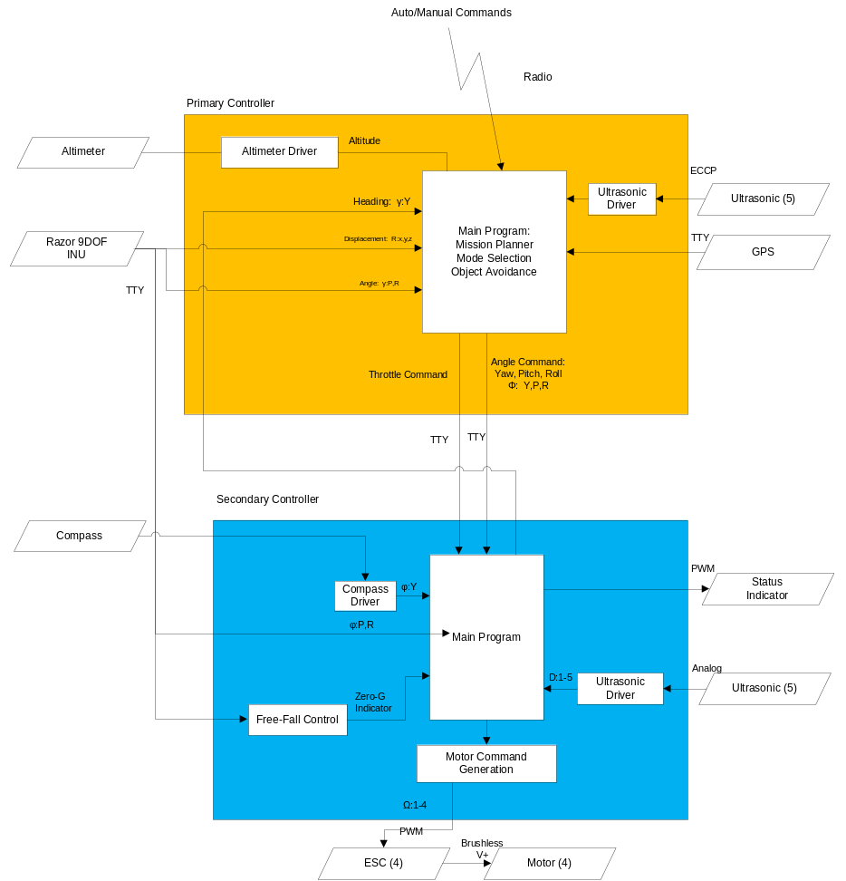
2 “Brains”, 1 SoM Board and
1 Parallax PropellerTM uC
SoM handles waypoint navigation, mission planning, vehicle health.
PropellerTM uC handles PWM generation, Kalman Filter.
In the event of an in-air mishap, PropellerTM uC can take over Vehicle and land safely.

Slide 9

Sensors: 3-Axis Accelerometer, 3-Axis Gyroscope, 3-Axis Magnetometer (INU), Digital Compass, Altimeter, GPS, 5 Ultrasonic Sensors
Power: 4 Brushless DC 200 Watt Motors, 2 Lithium-Ion 11.1V 5 Amp-Hours Batteries, 4 18A Electronic Speed Controllers, 5V and 3.3V Linear Voltage Regulators.
Control: SoM Controller (Primary), Propeller Controller (Secondary), custom PCB.
Communications: Xbee Radio for Command/Control, Video Transmitter, Wi-Fi (Field programming, tentative).
Fabrication: ~50% COTS, ~50% produced by MakerBot.

Slide 10






Pitch
CCW
CW
Roll
CW
CW
CW
CW
Yaw
CCW
CW
CW
Forward
CW: Puller
CCW: Pusher

Slide 11

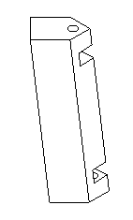
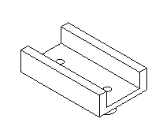
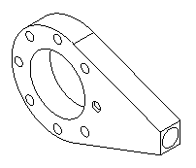
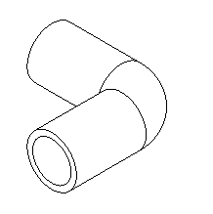
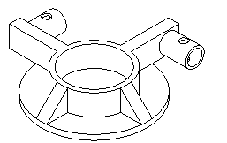
Gear Brace x4
Motor Coupler x8
Electrical Board
Support x3
Sonar Mount x4
Elbow x8

Slide 12


Custom PCB inside Xbox-360 Controller
Features Mode and Error Display, Vehicle Battery Indicator, Force-Feedback and 5 hours of continuous operation.

Slide 13

Communications: XBee Radio for Command/Control
Input/Output: 9 Switches/Buttons, 2 Dual-Axis Joysticks, GPS Sensor, 10-Segment LED, LCD Screen, Vibrating Motors.
Power: 2 Ni-Mh AA Batteries, 3.3 and 5V Boost Converters.

Slide 14
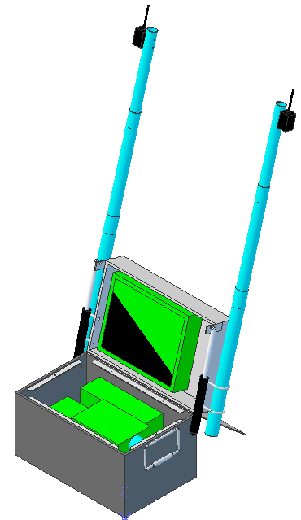
GCS
Includes computer, touch-screen monitor and batteries for field operation.
Communications Radio and Video Receiver
Heavy-duty field transportable case

Slide 15


GCS offers extended range – up to 3 km
Interface designed in LabView
Google Earth integration with Internet connection

Slide 16

Software: National Instruments LabView integrated with Google Earth mapping software.
Power: 2 12V 26Amp-Hour Batteries, 120V AC Power Inverter, Vehicle battery fast charger.
Communications: XBee Radio for Command/Control, Video Receiver

Slide 17
Test-Stand
Used for Vehicle Calibration and Capacity measurements
Able to Pivot vertically, rotate continuously and pitch/yaw/roll on Test-Fixture Assembly
Power applied to Vehicle via Slip-Ring – No tangled wires

Slide 18

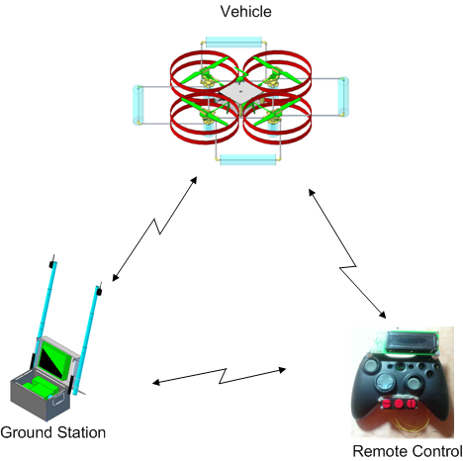
Using XBee API Mode, Vehicle, GCS and RCU all talk to each other
RCU and GCS can extend flight range of Vehicle due to API mesh network.

Slide 19

4 Command/Control Links
Assumptions:
Communications Channel will be “filled”.
No dropped packets
Follows ICARUS Communications Protocol
Link | Vehicle-RCU (Manual Mode, Wireless) |  | Vehicle-GCS (Manual Mode, Wireless) |  | RCU-GCS (Wireless) |  | Primary-Secondary (Wired)
Parameter | TX | RX | TX | RX | TX | RX | TX | RX
Selected Messages | ERR,MAN-# | ERR,STA-POWMV,STA-COND | ERR,MAN-# | ERR,SEN-INU,STA-POWMV,STA-POW5V,STA-POWMC,STA-BEAR,STA-DIST,STA-ALT,STA-GPSFIX,STA-INUFIX,STA-COND | ERR,STA-COND | ERR,STA-COND | ERR,MAN-#, | ERR,SEN-INU,
Traffic (Bytes) | 30 | 7.5 | 30 | 65.12 | 5.2 | 5.2 | 30 | 54
Baud Rate (bps) | 9600 |  | 9600 |  | 9600 |  | 115200
Update Freq (hz) | 40.00 | 160.00 | 40.00 | 18.43 | 230.77 | 230.77 | 480.00 | 266.67

Slide 20

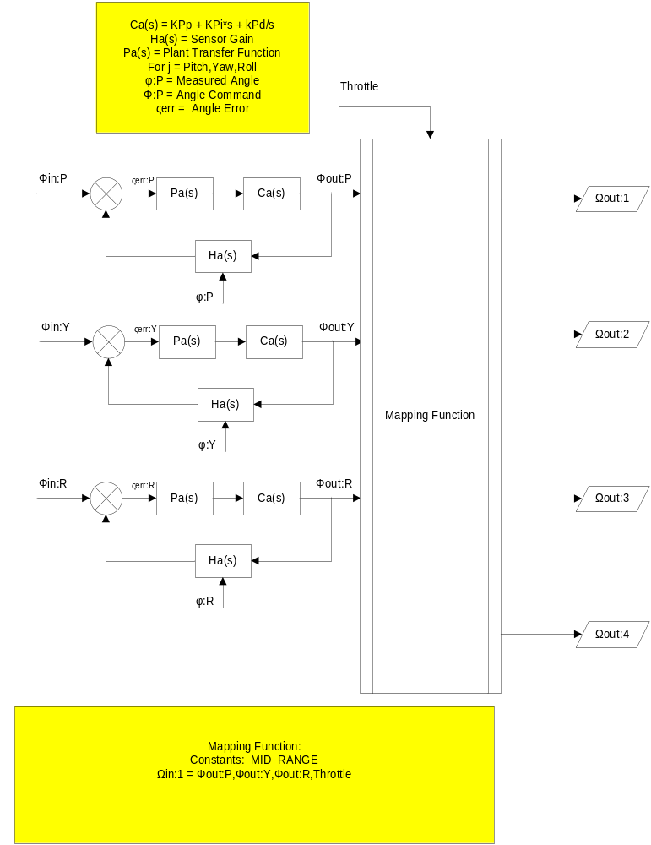

Slide 21

Capabilities - Planned
Manual Control via RCU or GCS | Simple Calibration and Testing via Test-Stand
Limited Autonomous Navigation via RCU | Error Display on RCU and GCS
Waypoint Navigation | Force-Feedback on RCU
Automatic Takeoff, Hover and Landing | Vehicle Health Reporting
Capabilities - Future
Real-Time Video Transmission to GCS | Image Capture
Wireless airborne programming | Advanced Hover modes
Vehicle Status Audio via RCU | Extended System Duration
Configurable Payloads | Terrain Following

Slide 22

Range: ~1.5 km LOS (~3km with Xbee Mesh Network)
Duration:
  Vehicle: ~12 min (80% Throttle)
  RCU: ~4-6 hrs
  GCS: ~4-6 hrs (including field charging Vehicle)
Speed: ~2 - 4 kph
Weight: ~5.5 lbs
Size: 35” x 35” x 7”
Propeller Rotation: Max: 10,000 RPM
Vertical Thrust: ~7.8 lbs
Notes:
*Educated Guesses

Slide 23

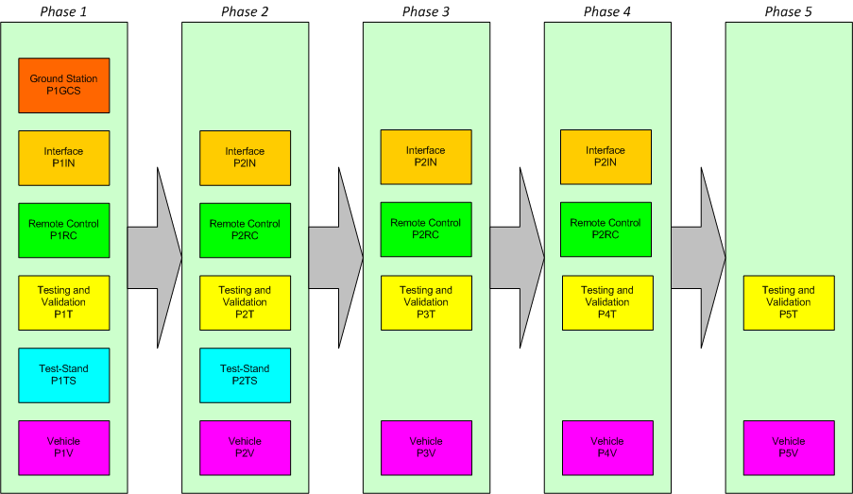

Slide 24
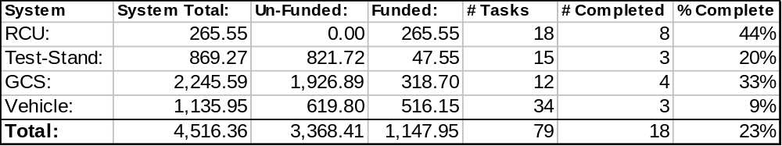
Cost: 25% of material/part cost invested.
Tasks: 23% of defined tasks completed.
Currently in Phase 1 with limited development in Phase 2.

Slide 25

Senior Design
  Automatic Helipad
  Video Intelligence/guidance
  Airframe design/analysis
Masters/PhD Program
  System modeling/analysis
  Control System
  Object avoidance/terrain mapping

Slide 26

Communications
Control System
Flight Power

Slide 27


Contact:
  David Gitz: davidgitz@gmail.com

